Slide 1

Current Citizen Complaint Process

Slide 2
Citizen Complaint- from start to finish
Complaint filed with DPD in a variety of ways
Phone call or email; to a police division or to Professional Standards Bureau (“PSB”)
Anonymous complaints are accepted but not common
Investigation performed
Often the Supervisor of the subject of the complaint handles investigation
If nature of complaint is of more serious nature PSB will perform investigation
All complaints are logged and tracked in IAPro/BlueTeam software

Slide 3
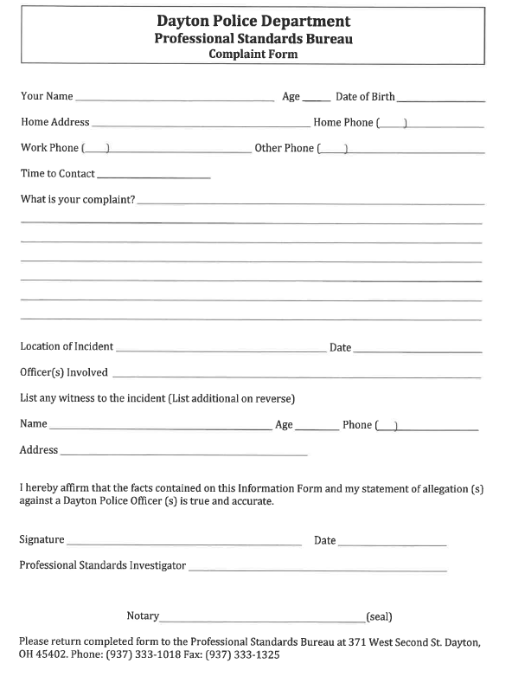

Slide 4
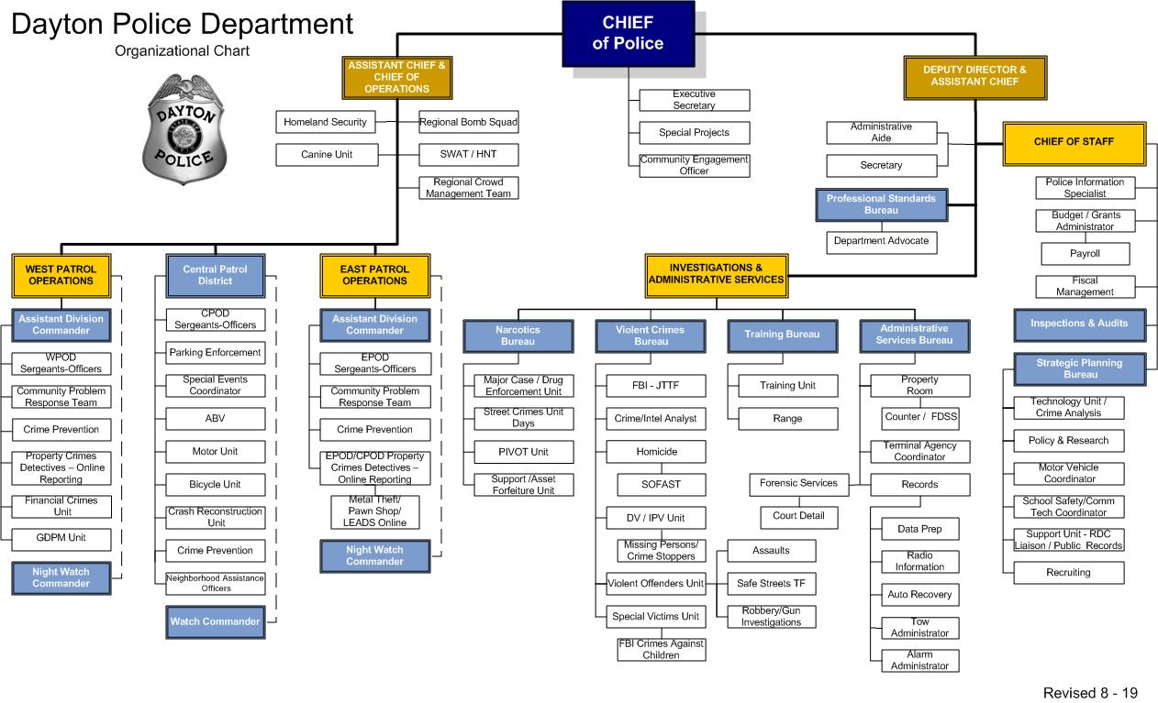
4

Slide 5
Citizen Complaint- from start to finish
Four Dispositions of Investigations:
Sustained- the investigation established sufficient evidence to clearly show that the wrongful act alleged in the complaint did occur
Not Sustained- that the investigation was unable to find sufficient evidence to prove or disprove the allegations of the wrongful act made in the complaint
Exonerated- the act described in the complaint did occur, however, the investigation revealed the act was lawful and in accordance with established department policy and procedure
Unfounded- the investigation proved conclusively that the alleged act did not occur and/or the accused officer did not commit the act or there is no credible evidence to support the complaint

Slide 6
Citizen Complaint- from start to finish
If Disposition is Not Sustained, Exonerated or Unfounded, the written report of investigation is reviewed at all levels through the chain of command
If Disposition is Sustained and recommended discipline is written reprimand or lesser penalty, the written report of investigation is reviewed at all levels through the chain of command and discipline is administered
If Disposition is Sustained and recommended discipline is suspension or greater, then Human Resources is asked to review the matter and generate charges and specifications

Slide 7
Citizens Appeal Board
If citizen disagrees with outcome of the investigation they have right of appeal to Citizens Appeal Board (“CAB”)
CAB is appointed by City Commission and not part of DPD
CAB is comprised of five voting members
One member should be a former member of law enforcement, one member from legal community, and the other three members shall be selected at-large
Each member serves a two year term. No member may serve more than three consecutive terms
Assistant City Manager and Chief of Police serve as ex-officio nonvoting members

Slide 8
Citizens Appeal Board
Appeal must be filed to CAB within 30 days of PSB issuing findings
Appeal form is sent with letter of PSB findings

Slide 9
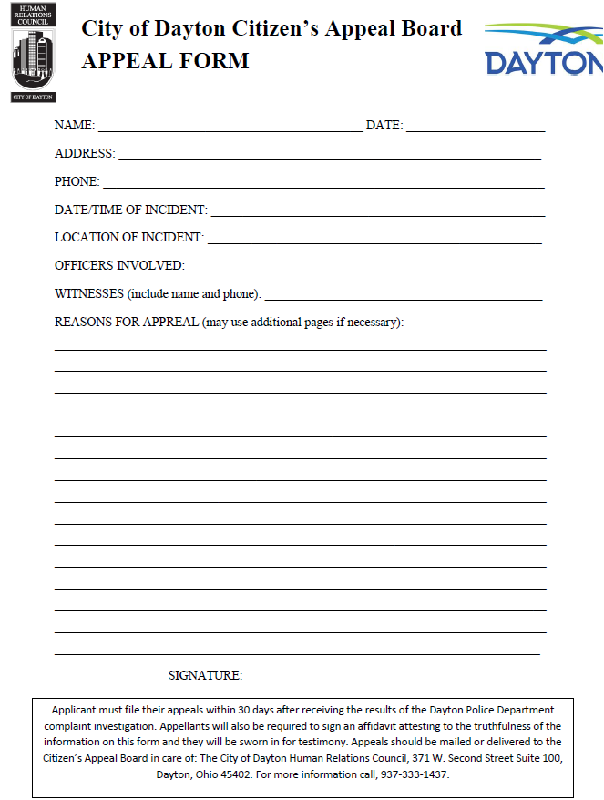

Slide 10
Citizens Appeal Board
CAB will review the Police Department’s investigation of the citizen’s complaint and the information provided in the appeal form
CAB will hear testimony from the appellant, may subpoena witnesses, and may request additional investigation by the PSB
CAB then determines whether it sustains or does not sustain the PSB’s investigation findings

Slide 11
Citizens Appeal Board
CAB will submit findings to City Commission and recommendations become public record
CAB does not have disciplinary authority but will determine whether it concurs with PSB investigation
Discipline of employee is generally determined solely by Chief of Police because it is a “personnel matter.”
The City Commission may meet with the Chief of Police to discuss the conclusions and seek additional remedies

